Slide 1


DEPARTMENT OF COMPUTER SCIENCE AND ENGINEERING(DATA SCIENCE)
SCHOOL OF COMPUTING
10214DS601/ MINOR PROJECT -1
SUMMER SEMESTER(2025-2026)
REVIEW-1
“SONAR ROCK AND MINE DETECTION USING MACHINE LEARNING”
Batch No:
PRESENTED BY
SUPERVISED BY
Dr.S.Karthika
Assistant Professor
M.E,Ph.D
1N.Muralikrishna(VTU25758)(23UEDC0047)
2.M.Siddharthreddy(VTU26758)(23UEDC0041)
3.B.Jagadeeswar (VTU25765)(23UEDC0005)

Slide 2
OVERVIEW
  ABSTRACT
  OBJECTIVES
  TIMELINE OF THE PROJECT
  INTRODUCTION
  LITERATURE REVIEW
  DESIGN AND METHODOLOGIES
  IMPLEMENTATION
  CONCLUSION
  REFERENCES

Slide 3
  ABSTRACT
  Introduction:
  SONAR Basics: SONAR uses sound waves to "see" underwater. It sends out a sound pulse and listens for the echo.
      To explore the potential of Federated Learning (FL) in discovering ASD biomarkers from diverse medical data sources without compromising patient privacy.
      To develop a federated learning framework for analyzing multimodal ASD data (e.g., neuroimaging, genetic, behavioral) across multiple institutions.
      Method:
      Data from various hospitals and research institutions is used for model training, with each site keeping its data local.
      Federated learning algorithms are employed to train a shared model on decentralized datasets, enabling collaborative learning while maintaining privacy.

Slide 4
Result:
The identified biomarkers show promising consistency across different datasets, suggesting generalizability of the findings.
The federated approach reduces data-sharing challenges while maintaining competitive performance compared to centralized models.
Conclusion:
The approach is a viable solution to overcome data privacy issues while enabling collaborative research on neurodevelopmental disorders.
Future studies can extend this framework to larger, more diverse datasets to enhance the robustness and accuracy of ASD biomarkers.

Slide 5
  OBJECTIVES
Objective:
Discover reliable biomarkers that can help in detection of Autism.
Ensure privacy-preserving analysis using federated learning methods.
Improve accuracy and reliability of Autism diagnosis through data-driven insights.
Scope:
Study and identify potential biomarkers related to Autism using medical data.
Apply federated learning techniques so that data from different sources can be used securely without sharing patient information.

Slide 6
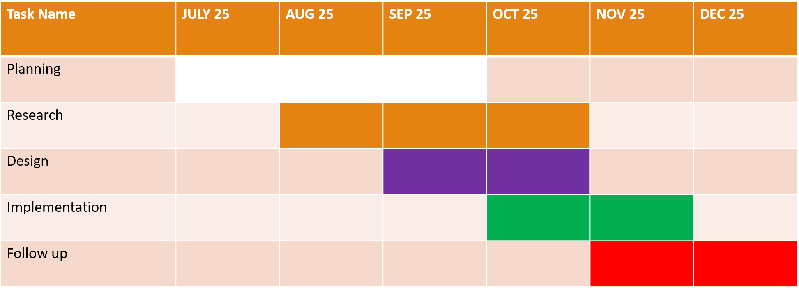
TIMELINE OF THE PROJECT
Sample Gantt Chart

Slide 7
  INTRODUCTION
  Autism Spectrum Disorder (ASD) affects approximately 1 in 54 children, yet early diagnosis and effective treatments remain challenging due to its heterogeneous nature.
  Despite advancements in neuroimaging, genetics, and behavioral analysis, identifying reliable biomarkers for ASD remains elusive.
  Early detection and personalized interventions could dramatically improve outcomes for individuals with ASD, but data privacy and sharing restrictions present major roadblocks.
  Federated Learning (FL) offers a cutting-edge solution by enabling the training of machine learning models without sharing patient data, while still leveraging multiple datasets for robust analysis.
  This project aims to explore the feasibility of using Federated Learning to discover ASD biomarkers across decentralized data sources, ensuring privacy while enhancing diagnostic accuracy.
  Traditional machine learning models often require centralized data, posing challenges for privacy, especially with sensitive medical and behavioral data.

Slide 8
  LITERATURE REVIEW
Author’s Name | Paper name and publication details | Year of publication | Main content of the paper
Gupta, Bhuiyan M.R.I., Chowa Montaha S., Rahaman R | Enhancing Autism Spectrum Disorder Classification with Lightweight Quantized CNNs and Federated Learning on ABIDE-I Dataset | 2024 | Developed a federated learning framework using quantized 1D-CNN on fMRI data. Best results achieved with CC200 brain atlas and specific filtering methods.
FedHNN | Identifying autism spectrum disorder from multi-modal data with privacy-preserving (FedHNN) | 2024 | Combines federated learning with hypegraph neural networks and multi modal inputs.

Slide 9
Zhengning Wang et al. | Autistic Spectrum Disorder Detection and Structural Biomarker Identification Using Self-Attention Model and Individual-Level Morphological Covariance Brain Networks Published in: Frontiers in Neuroscience | 2024 | Not federated learning, but strong on biomarker discovery uses self-attention to find structural biomarkers: prefrontal cortex, temporal cortex, cerebellum, and pallidum. Good for interpretability in ASD.
Jin Liu, Junbin Mao, Hanhe Lin, et al. | Multi-modalMulti-kernel Graph Learning for Autism Prediction and Biomarker Discovery (arXiv, accepted manuscript | 2023 | Graph learning across multiple modalities (e.g. fMRI, structural MRI) for ASD prediction; identifies discriminative brain regions; strong in discovering biomarkers. No FL in this work.

Slide 10
  DESIGN AND METHODOLOGIES
MODULE :Logistic Regression
Logistic Regression is used here as a binary classifier to predict whether a sample belongs to 0 or 1.
Predicts the probability of a sample belonging to a certain class using the logistic function.

Slide 11
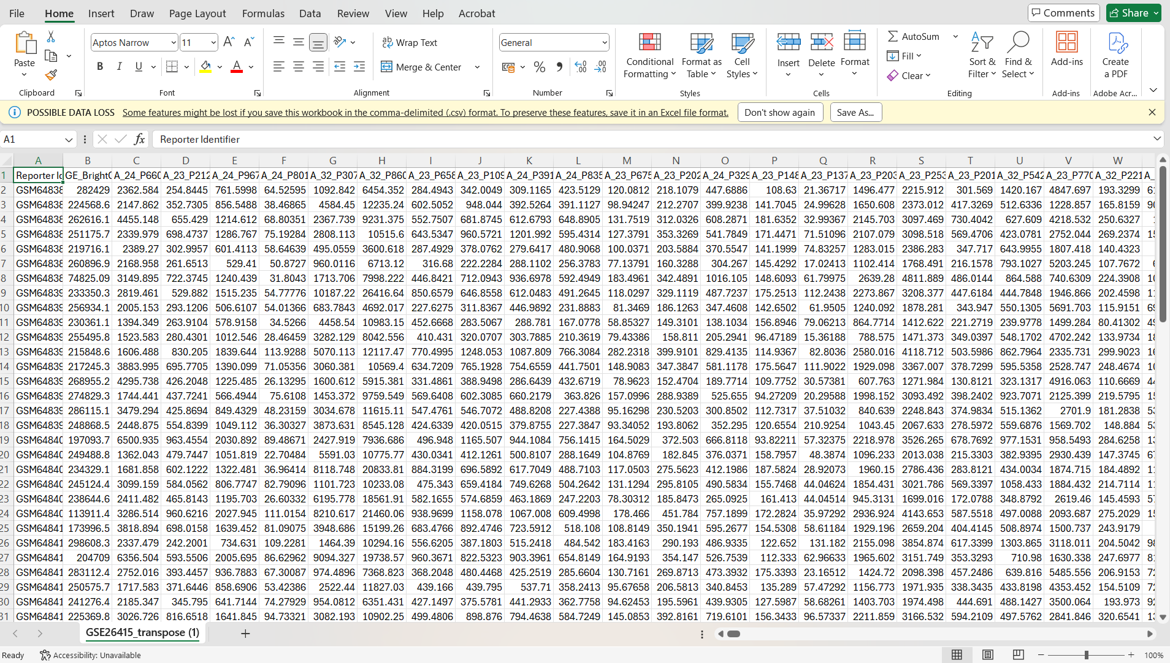
MODULE 1:
Step:1 Collection of data

Slide 12
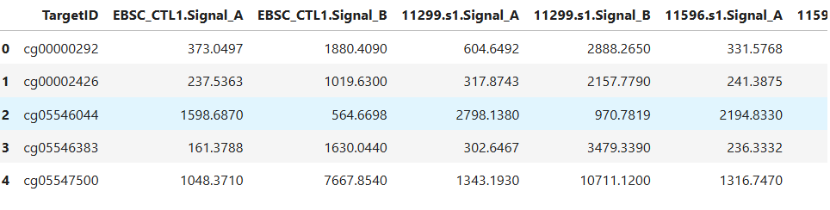
Step 2: Processing the data

Slide 13
Module 2-Federated algorithm
Federated Learning is an innovative approach that enables multiple institutions, such as hospitals, research labs, or clinics, to collaboratively train machine learning models without sharing raw patient data.
Instead of centralizing data, each site trains a model locally on its own dataset and only shares the learned model parameters with a central server. The most widely used FL algorithm is Federated Averaging which combines these local models by averaging their weights to form a global model.
While FedAvg works well when data across clients is similar real-world healthcare data is often non-IID. To address this, FedProx adds a regularization term to improve model performance in such scenarios.
Advanced algorithms like Federated Matched Averaging are used with deep neural networks to align and merge corresponding neurons across models.

Slide 14
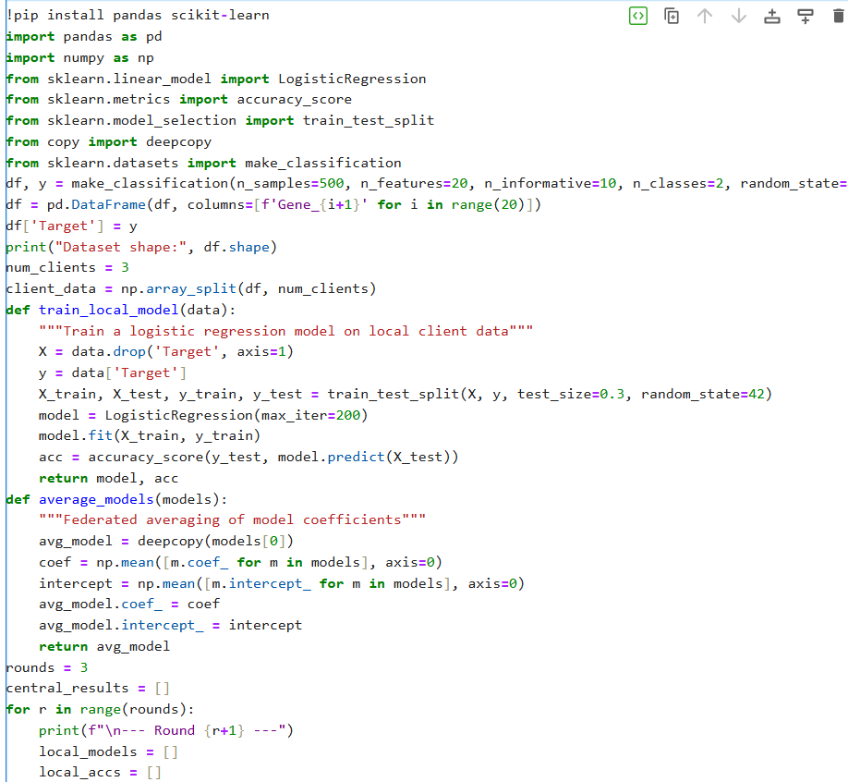
Step 3: Using algorithm

Slide 15
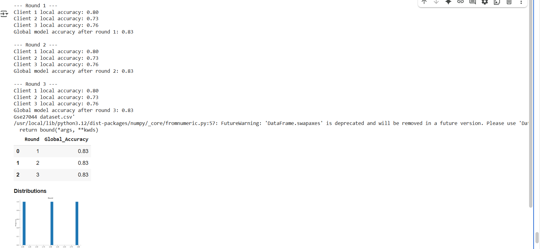
Step 4: The output

Slide 16
IMPLEMENTATION
Architecture Diagram
Data –Flow Diagram
Use Case Diagram
Class Diagram
Activity Diagram
Sequence Diagram
E-R Diagram

Slide 17
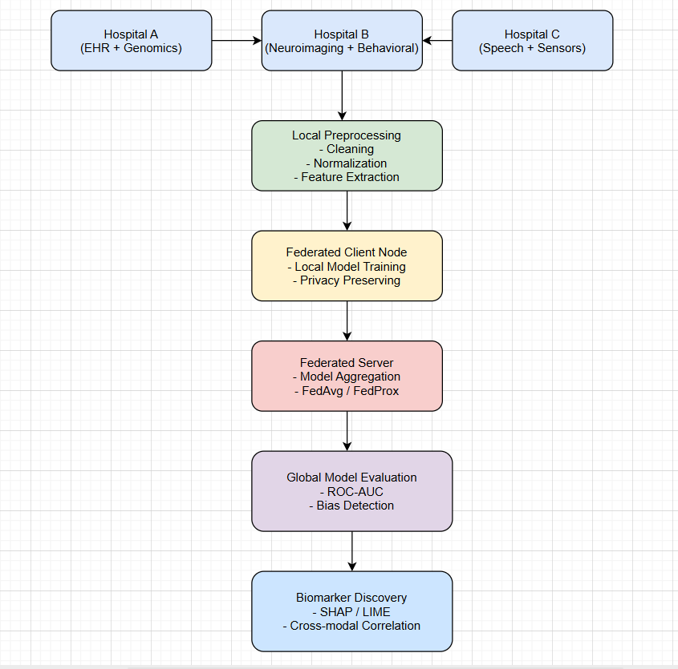
Architecture Diagram

Slide 18
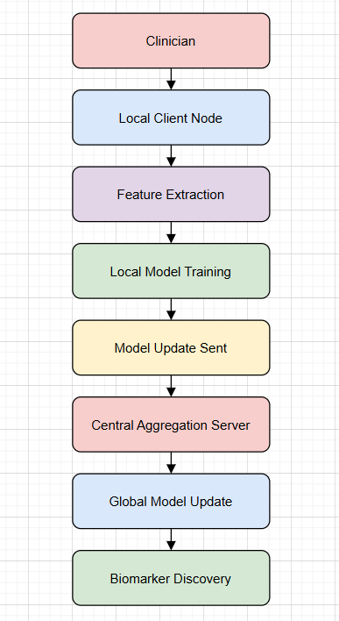
Data –Flow Diagram

Slide 19
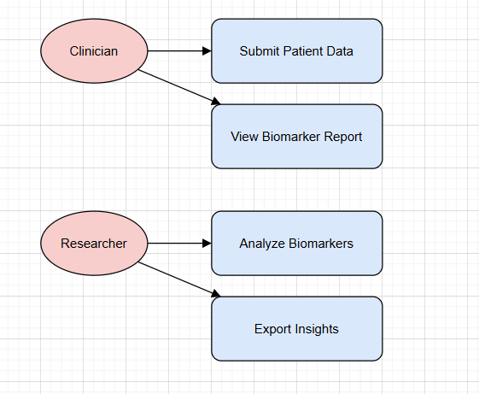
Use Case Diagram

Slide 20
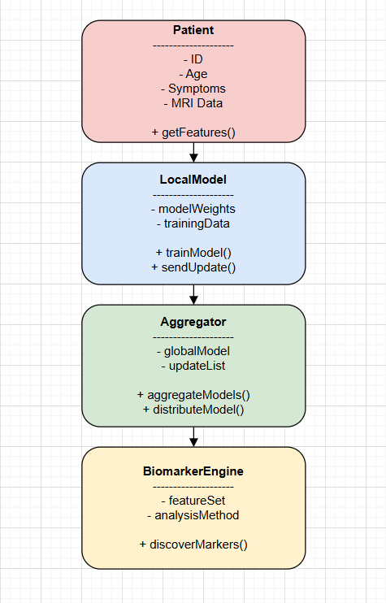
Class Diagram

Slide 21
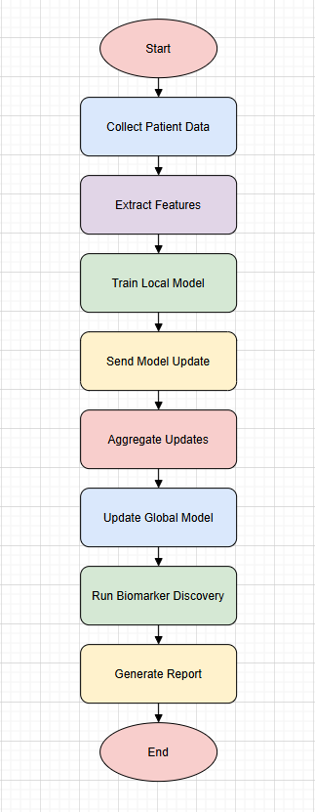
Activity Diagram

Slide 22
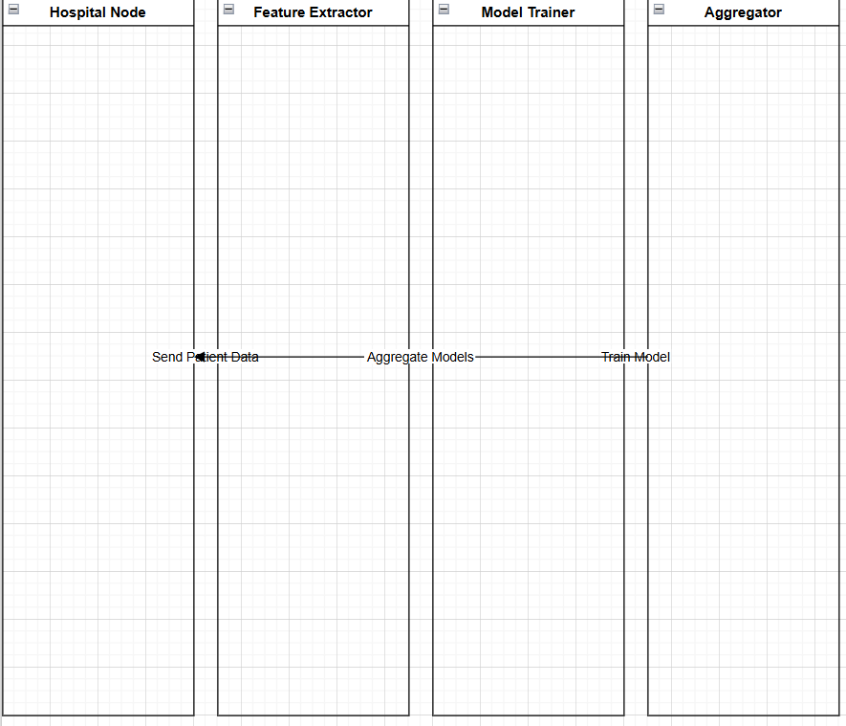
Sequence Diagram

Slide 23
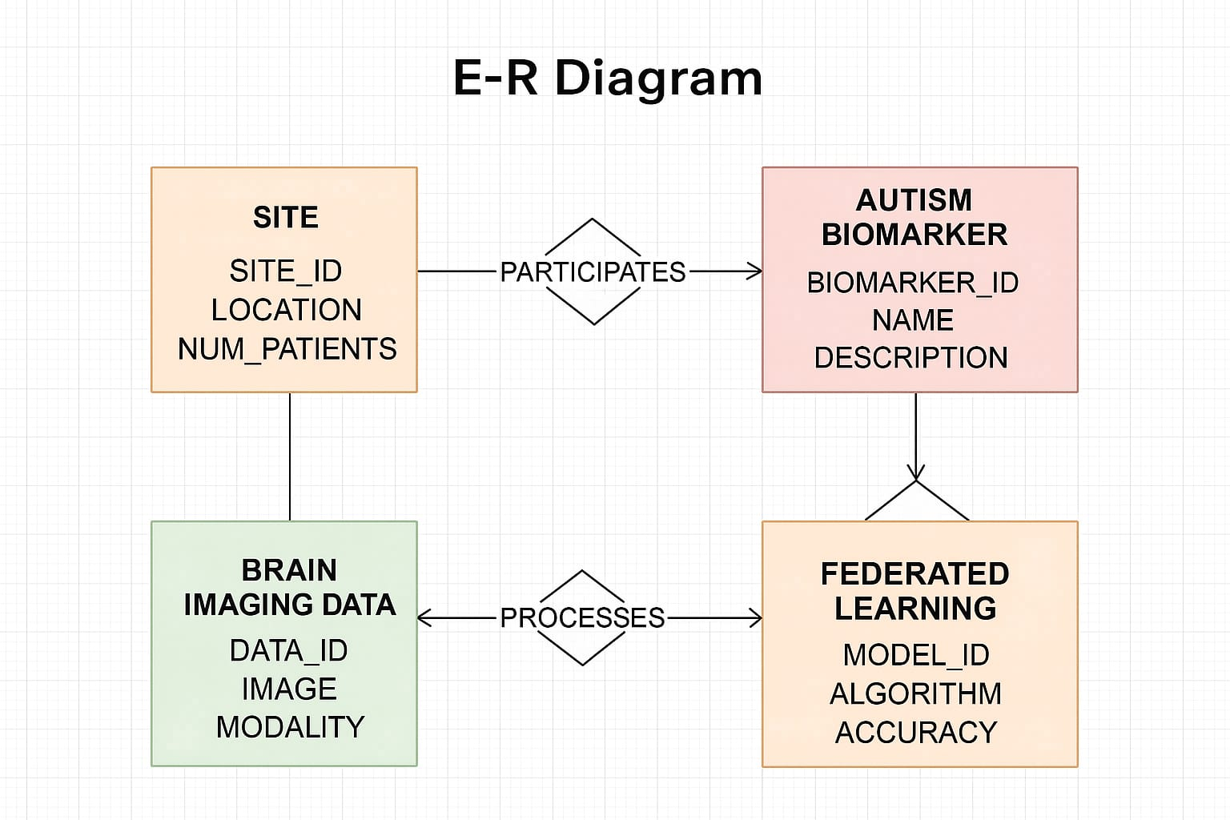

Slide 24
REFERENCES
R. V. Rodrigues, “Screening for common mental disorders using the SRQ-20 in medical students from Porto Velho-RO, Brazil,” J. Adv. Med. Pharmaceut. Sci., vol. 40, no. 2, pp. 33–45, 2021.
Z.-A. Huang, “Identifying autism spectrum disorder from resting-state fMRI using deep belief network,” IEEE Trans. Neural Netw. Learn. Syst., vol. 32, no. 7, pp. 2847–2861, Jul. 2021.
Z. Yang, “Functional informed fiber tracking using combination of diffusion and functional MRI,” IEEE Trans. Biomed. Eng., vol. 66, no. 3, pp. 794–801, Mar. 2019.
Z.-A. Huang, “Identification of autistic risk candidate genes and toxic chemicals via multilabel learning,” IEEE Trans. Neural Netw. Learn. Syst., vol. 32, no. 9, pp. 3971–3984, Sep. 2021.
Y. Chen, X. Sun, and Y. Jin, “Communication-efficient federated deep learning with layerwise asynchronous model update and temporally weighted aggregation,” IEEE Trans. Neural Netw. Learn. Syst., vol. 31, no. 10, pp. 4229–4238, Oct. 2020.

Slide 25
THANK YOU

